Slide 1
Medical data analysis
Cardio-vascular disease analysis with hypothesis testing (P-test)

Slide 2
Agenda
Introduction
The general dashboard
Descriptive Analysis
Hypothesis test for presence of disease

Slide 3
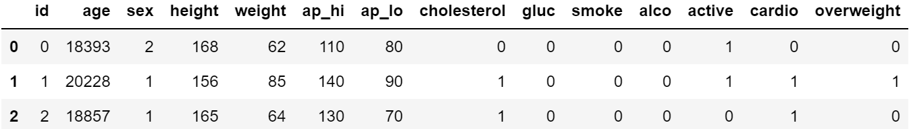
Introduction
This is an analysis project with statistical testing to find the relation between different health aspects and cardio-vascular disease presence .
The data is provided freeCodeCamp health research.
The data has following columns:-

Slide 4
The Power of
General dashboard

Slide 5
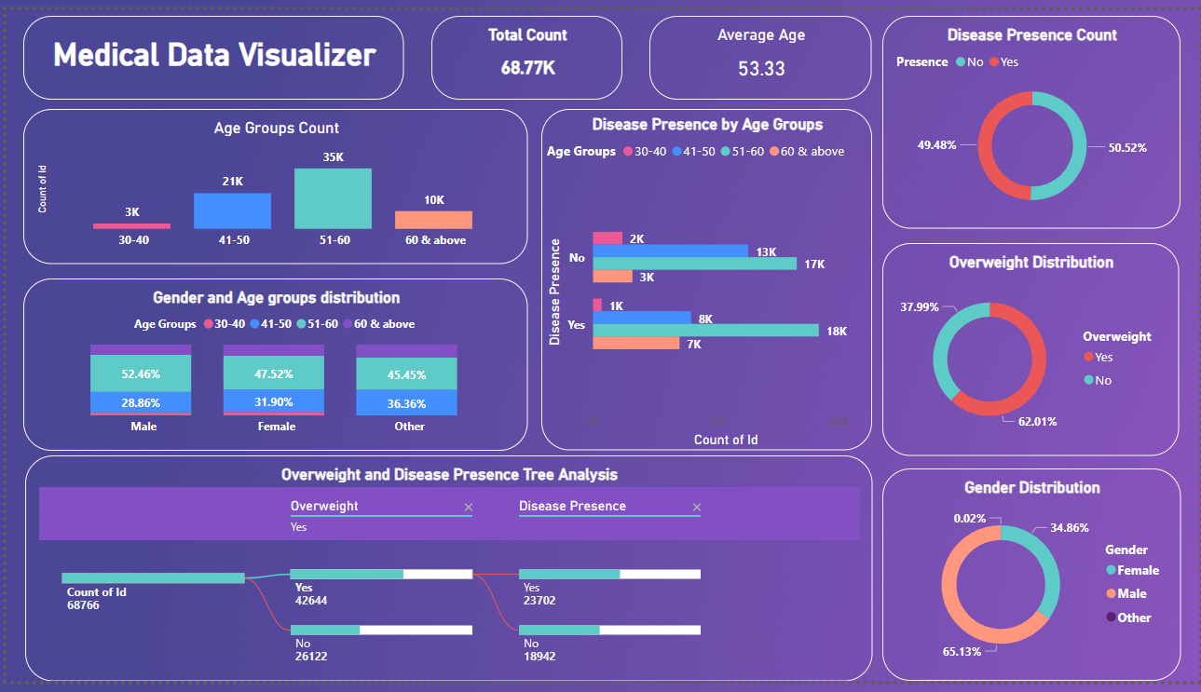

Slide 6
The Power of
Descriptive dashboard

Slide 7
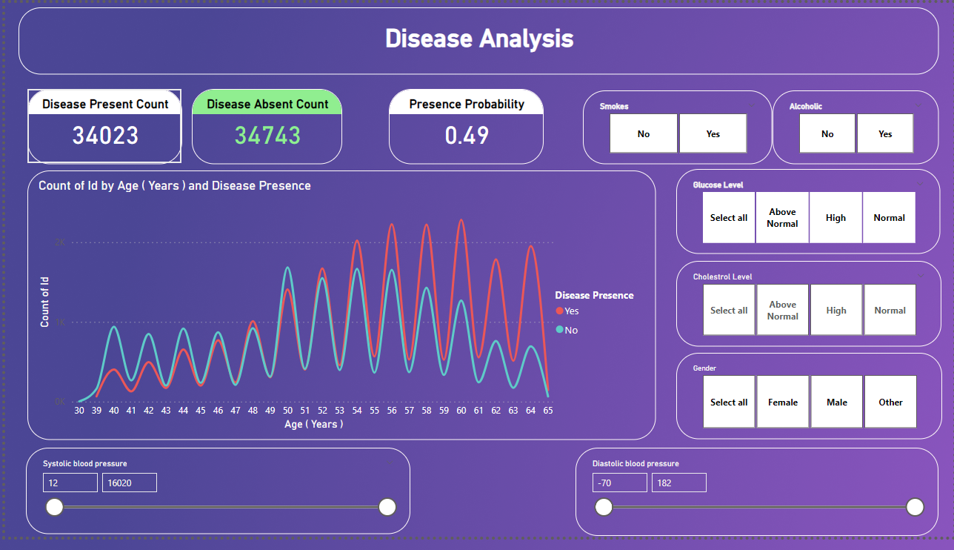

Slide 8
Insights
The count of total rows 68.77k.
The distribution of disease presence is 50.52% (Absent) and 49.48% (Present).
62.01% of total are overweight (BMI>25) and remaining are normal.
If the person smokes , is alcoholic and has higher cholesterol and glucose level ,the probability of disease presence is 0.74 and 1.00 for male.

Slide 9
Hypothesis test for overweightness and cardiovascular disease presence
P-test

Slide 10
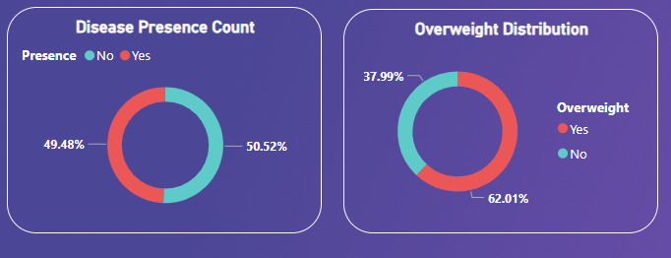

hypothesis
Null Hypothesis:-
“Being overweight does not affect the likelihood of having cardiovascular disease.”
$$p_{0}=0⋅6201$$
Alternative Hypothesis:-
“Being overweight increases the likelihood of having cardiovascular disease”

Slide 11


Data sampling
Data is 10% of total population with random selection to meet the condition of proper testing :-
Randomness
Normal Condition
Individuality
The results from sample are:-
Sample Size=7000
Sample Probability $\hat{p}=0.57$
z=−8.64
p=very small for α=0.005
$$z=\frac{\hat{p}−p_{0}}{\sqrt{\frac{p_{0}\left(1−p_{0}\right)}{n}}}$$

Slide 12

Results and conclusion
Since the p-value is much less than the typical significance level of 0.05, you reject the null hypothesis. This indicates there is strong evidence to suggest that being overweight significantly affects the likelihood of having cardiovascular disease

Slide 13
THANK YOU
Name | Varun Patil
Email-ID | varunpatil64228@gmail.com
LinkedIn | linkedin.com/in/varun-patil-797394241
GitHub | https://github.com/VARUN-688/

